Slide 1
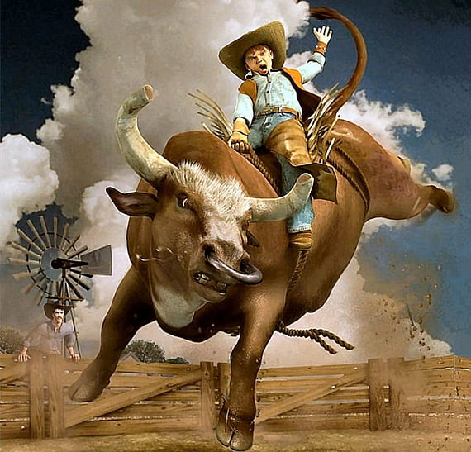
Volume
Techniques

Slide 2
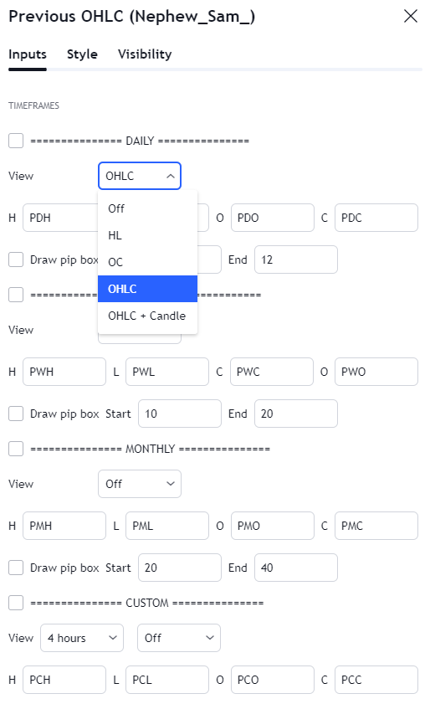
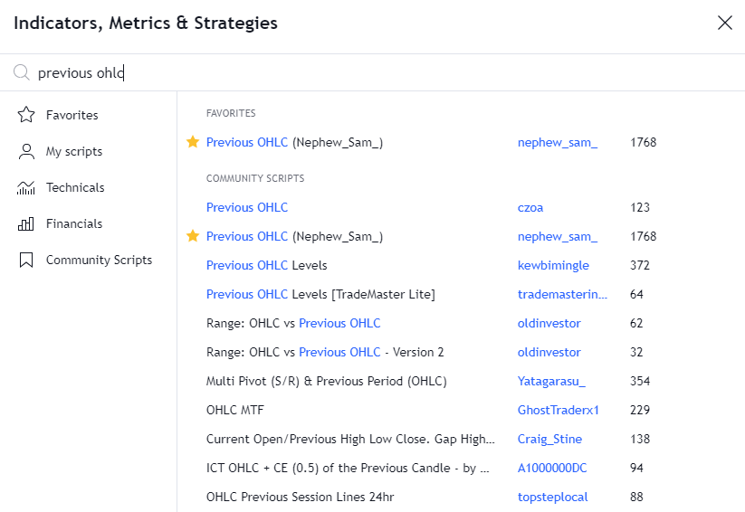
Previous OHLC

Slide 3
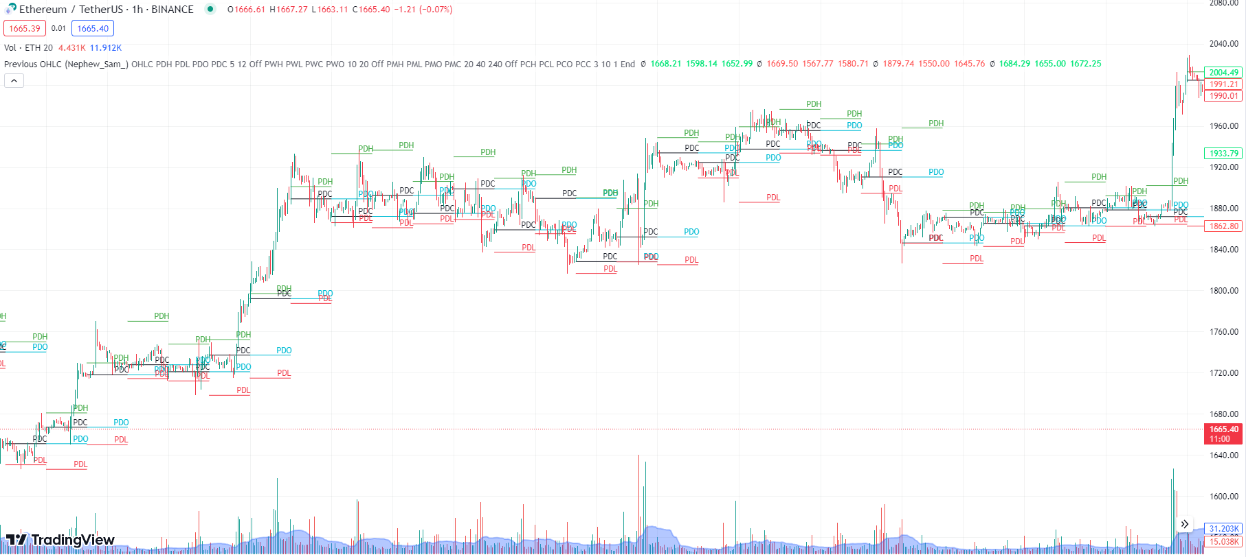
Previous OHLC (UT)
Notes:
1- In UT focus on volume at PDH + PDC
2- Need three consecutive significantly bullish vol bars
3- Volume should be more than previous sessions of the day – Will be marked as demand zone
4- Need Pumping candles (Obvious)

Slide 4
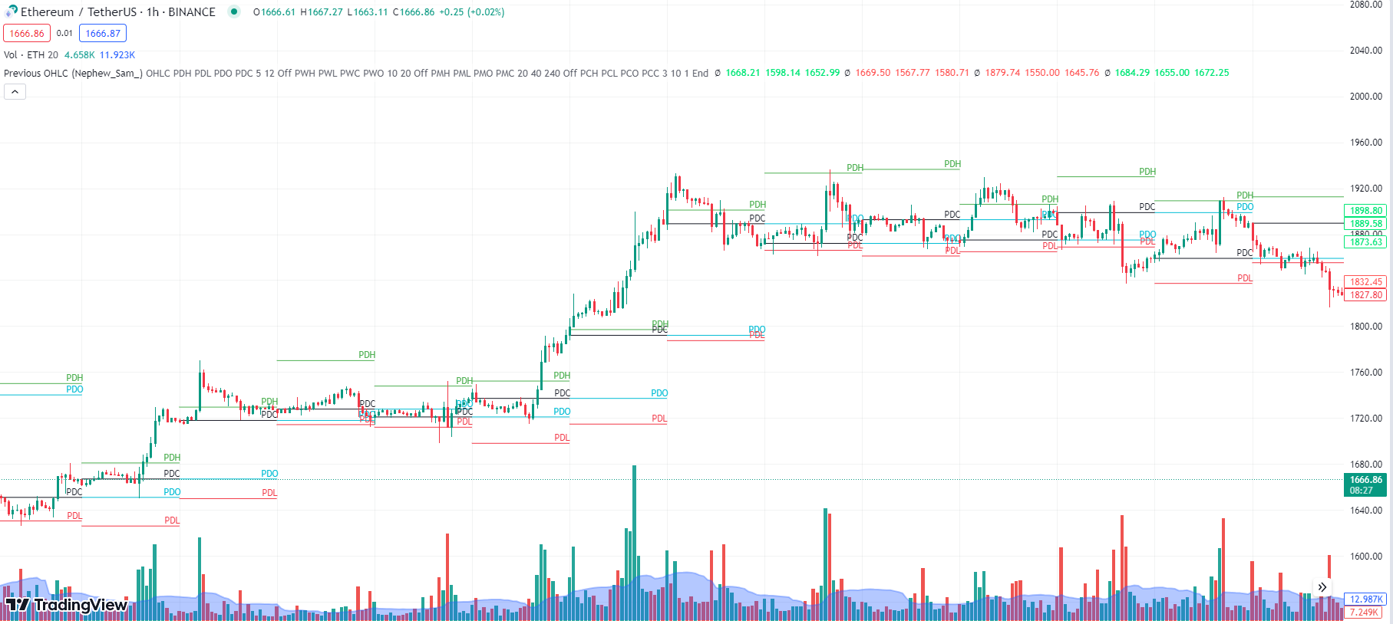
Previous OHLC (UT)

Slide 5
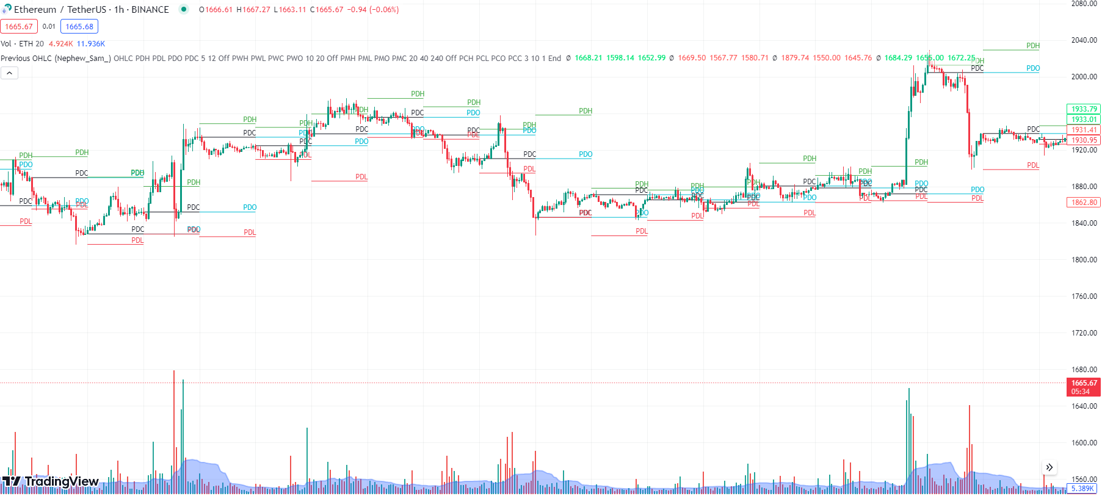
Previous OHLC (UT)

Slide 6
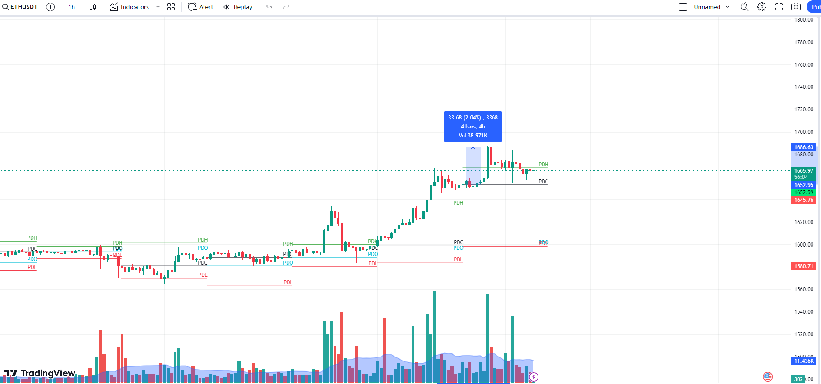
Retail Gains

Slide 7
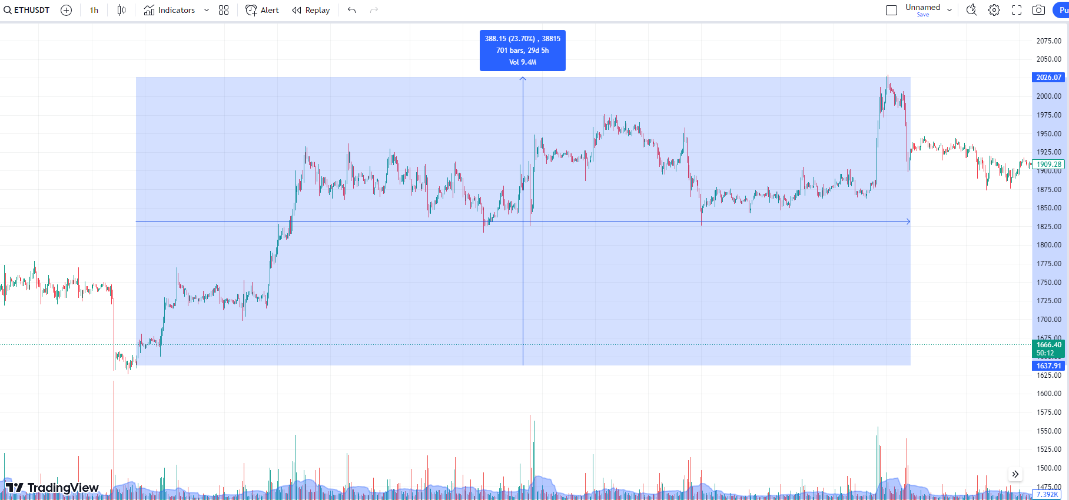
Whale Gains

Slide 8
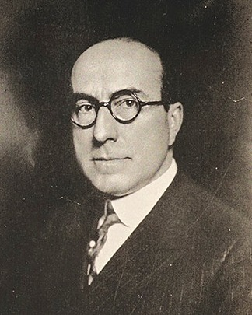
The Wyckoff Method
Richard Wyckoff
Four phases of Price Action
Accumulation
Uptrend
Reaccumulation/Distribution
Downtrend

Slide 9
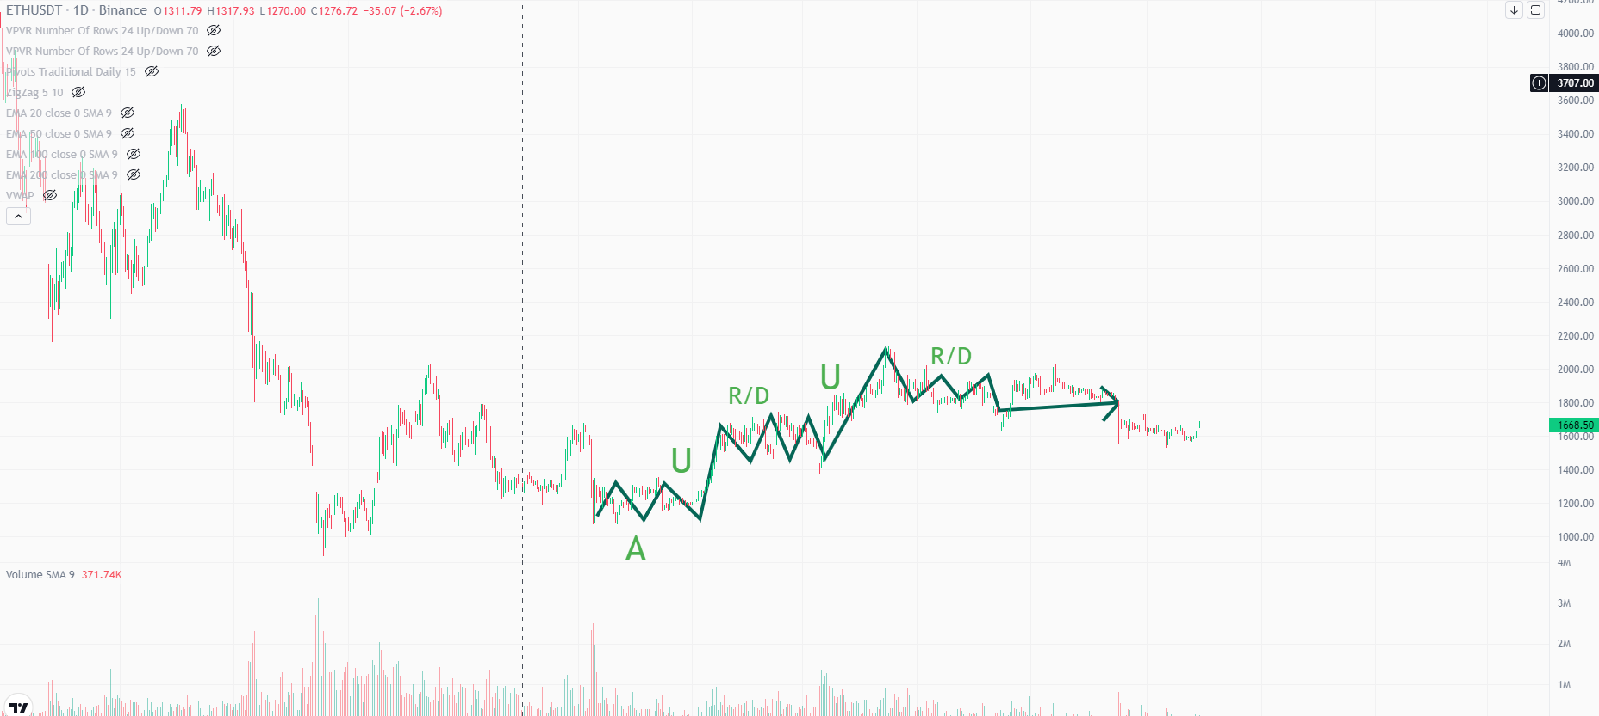
The Wyckoff Method

Slide 10
The Wyckoff Method
Asymmetry of Supply and Demand - Whales vs Retailers
Types of Supply and Demand
Aggressive - Market Orders - Hastens price movement
Aggressive Demand > Passive Supply - Bullish
Aggressive Supply > Passive Demand - Bearish
Passive - Limit Orders - Slows down price movement - Absorption
By placing limit orders, one side of market blocks the other.
Determinism - Cause and Effect - Length of Wyckoff Cycle
Notes:
length of accumulation vs length of upcoming trend.

Slide 11
The Wyckoff Method
Anomalies? Yes
In terms of Fast Reversal Patterns
Climax
Double Top/Bottom
Pullback (W/M)
Traps

Slide 12
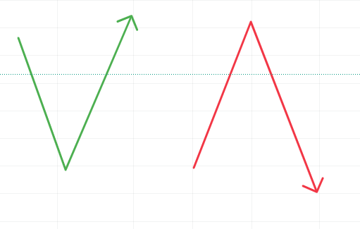
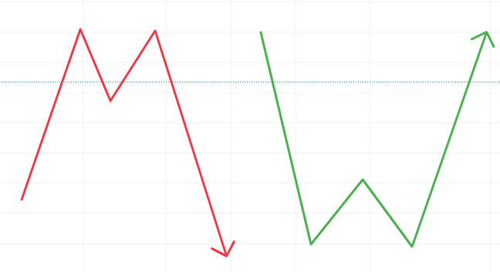
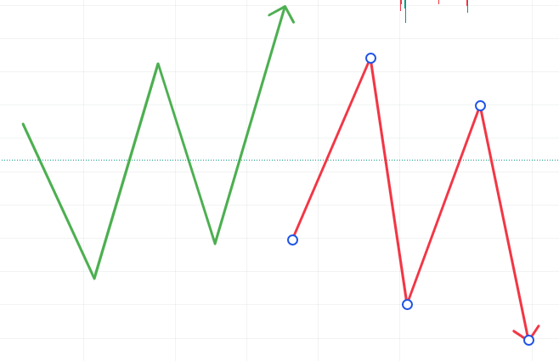
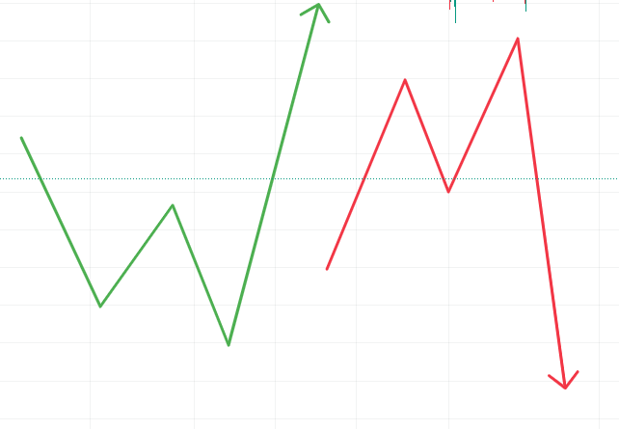
Anomaly Patterns

Slide 13
Harmony and Divergence
Volume ∝ Price
Harmony - When Price corresponds to volume
Divergence - When Price doesn’t reflect the volume

